Slide 1
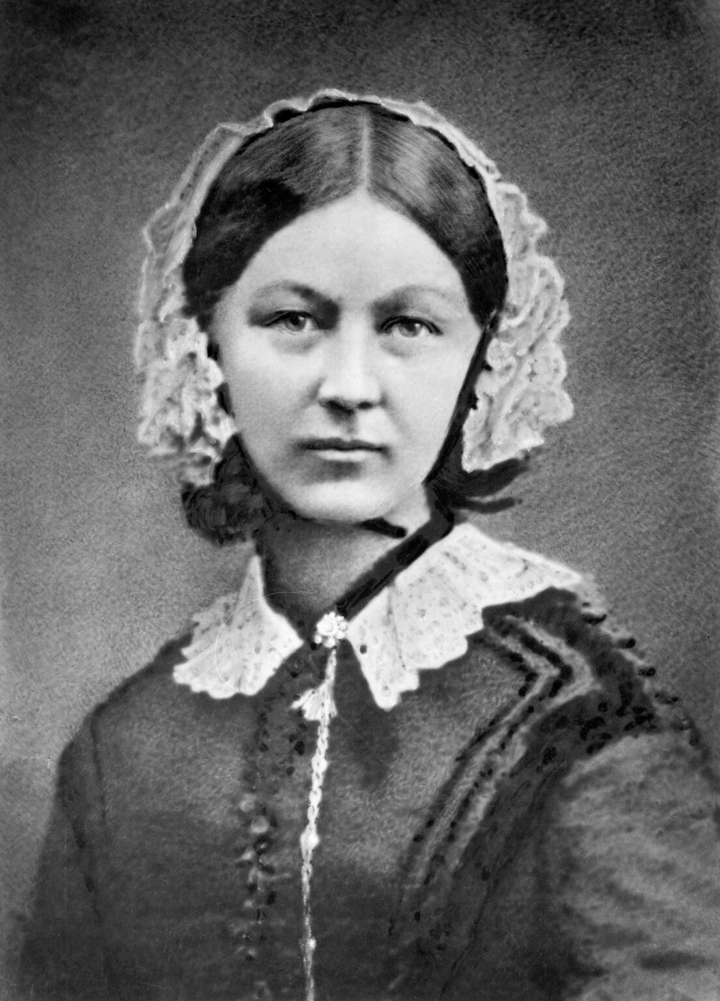
The face of data visualization

Slide 2
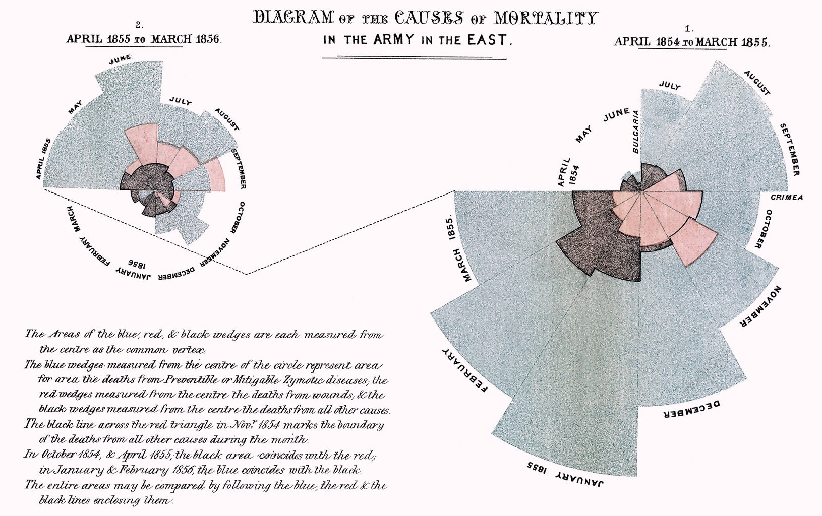

Slide 3
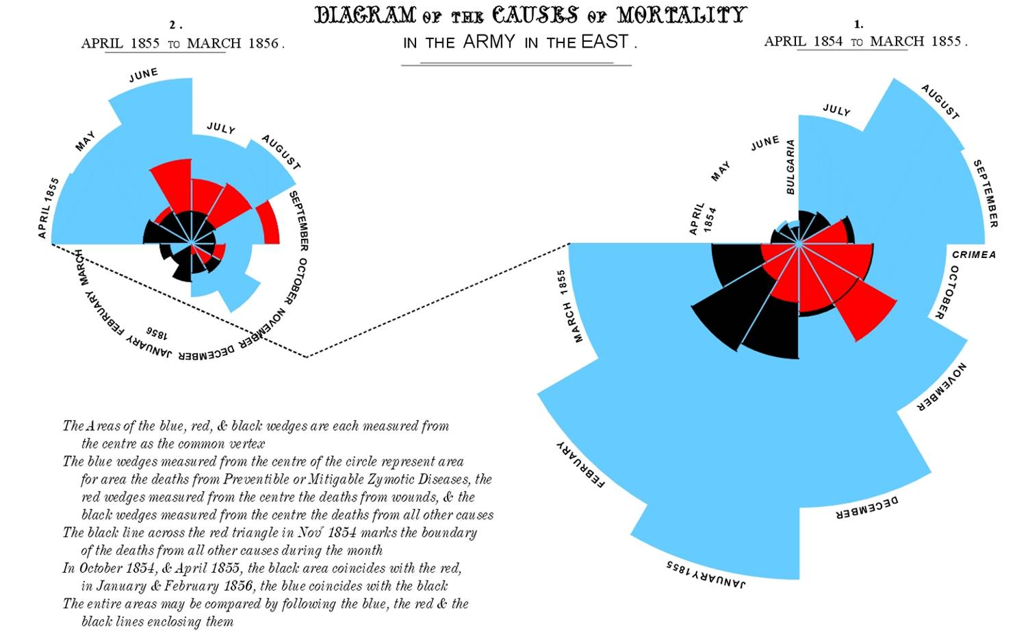
https://timharford.com/2021/03/cautionary-tales-florence-nightingale-and-her-geeks-declare-war-on-death/

Slide 4
Visuals Best Practices…

Slide 5
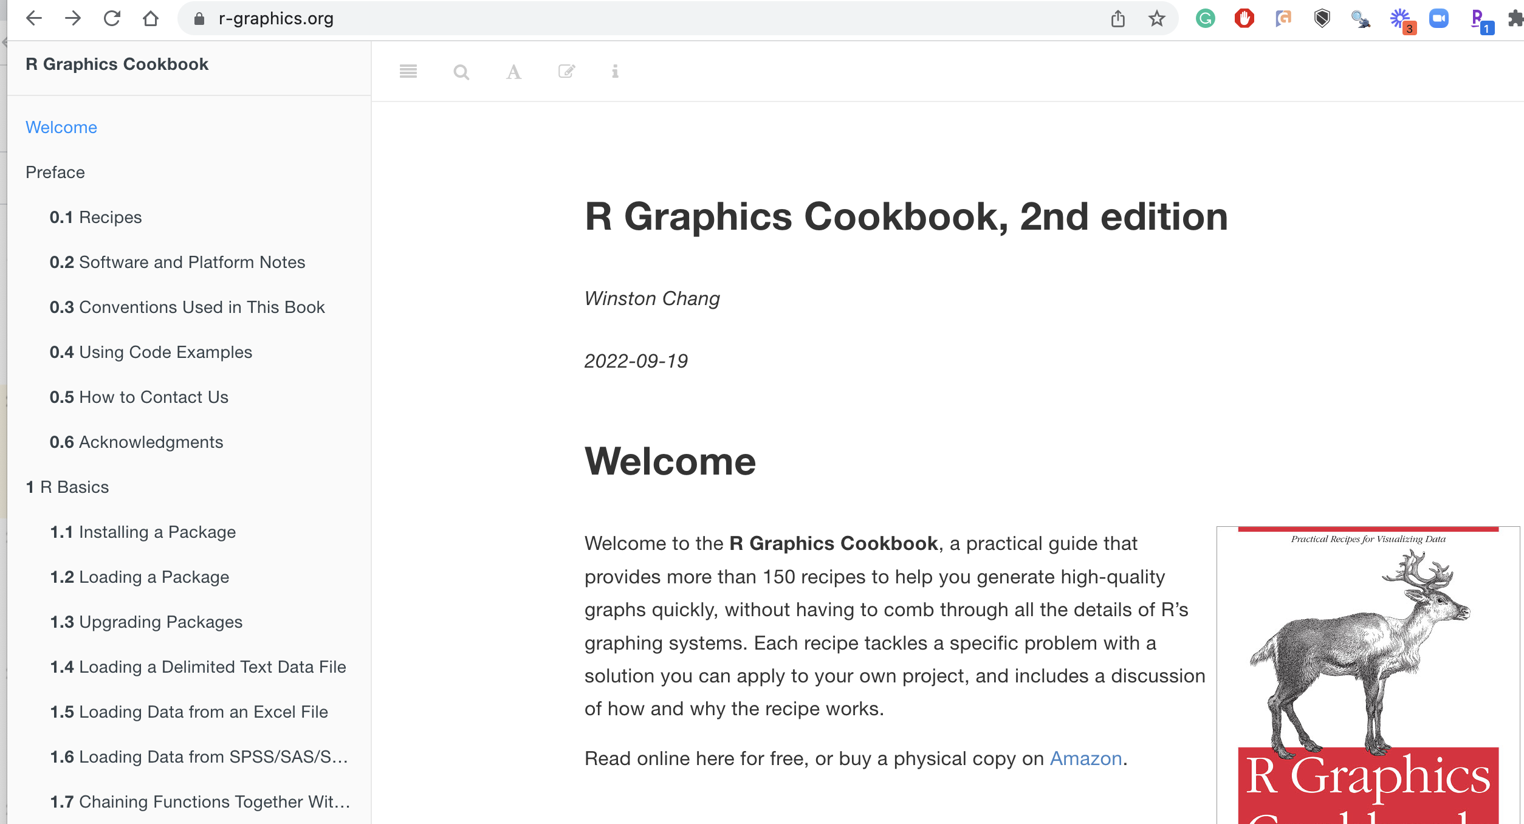
Choose [or lookup] the right chart
https://r-graphics.org/

Slide 6
Best Practices
Simplify - Just like an artist can capture the essence of an emotion with just a few lines, good data visualization captures the essence of data - without oversimplifying.
We don't want a tool that gives us 19 more options after we decide we want a column graph. We want a tool like Tableau that knows which visualization is appropriate and then creates it. Simple.
Compare - We need to be able to compare our data visualizations side by side. We can't hold the details of our data visualizations in our memory - shift the burden of effort to our eyes.
Attend - The tool needs to make it easy for us to attend to the data that's really important. Our brains are easily encouraged to pay attention to the relevant or irrelevant details. Stephen demonstrated this convincingly with a video similar to Daniel Simon's classic gorilla and ball passing.
Explore - Data visualization tools should let us just look. Not just to answer a specific question, but to explore data and discover things. Directed and exploratory analysis are equally valid, but we need to be sure that out visualization tool makes both possible.
View Diversely - Different views of the same data provide different insights. It helps to be able to look at the same data from different perspectives at the same time and see how they fit together.
Ask why - More than knowing "what's happening", we need to know "why it's happening". This is where actionable results come from.
https://www.tableau.com/blog/stephen-few-data-visualization

Slide 7
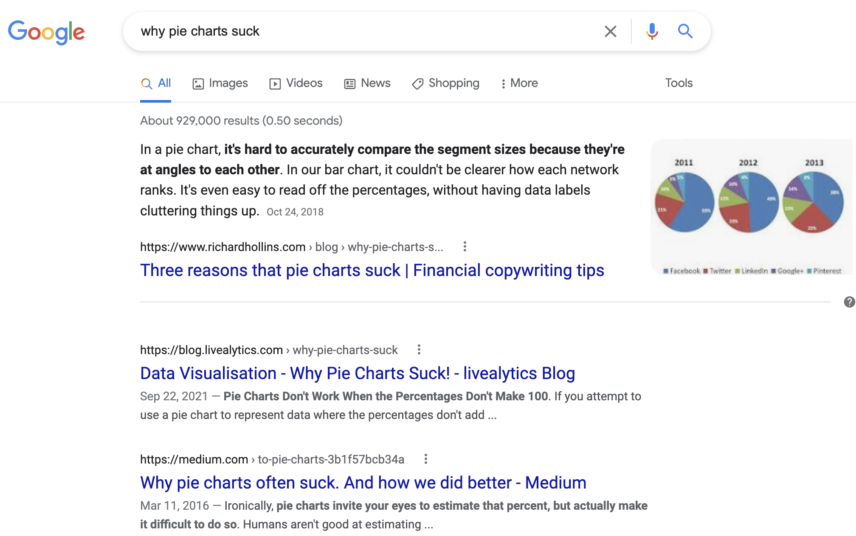
Avoid pie/donut charts

Slide 8
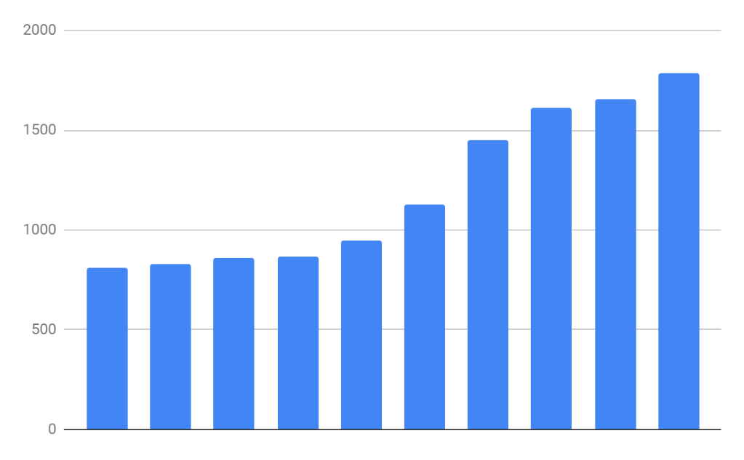
Instead

Slide 9
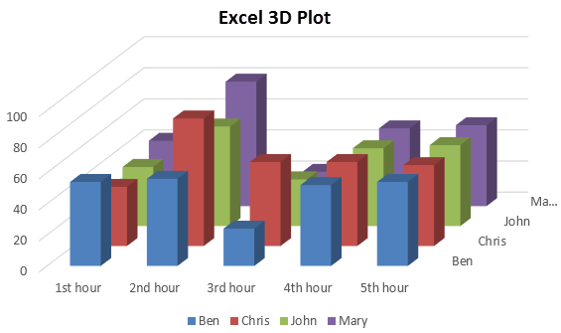
Avoid 3d charts

Slide 10
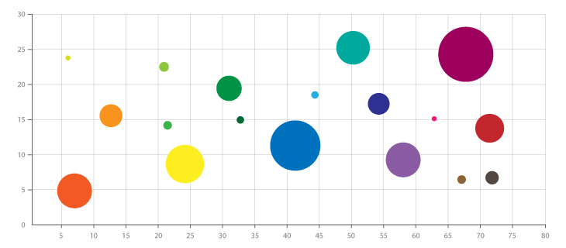
Instead
Show the 3rd dimension in a different manner
Colors, shapes size

Slide 11
Basic Bar Charts
Rectangles are representative of frequency or value
Frequency Matrix
Variable | freq
Grp1 | 0
Grp2 | 2
Grp3 | 3
… | 5
Grp_n | 2

Slide 12
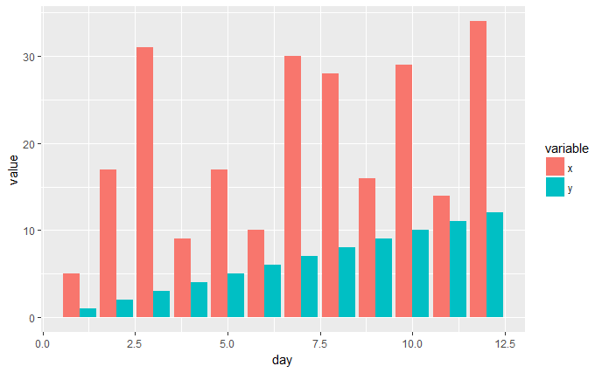
Side by Side Charts
Side by Side bar charts let you compare frequency by category

Slide 13
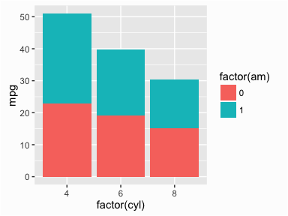
Stacked Bar Charts
Stacked bar charts lets you compare proportion within a category

Slide 14
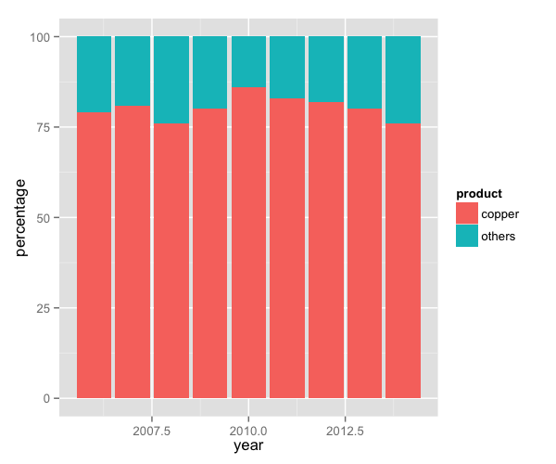
Proportional Stacked Bar Charts
Proportional stacked bar charts let you compare proportion across categories regardless of magnitude

Slide 15
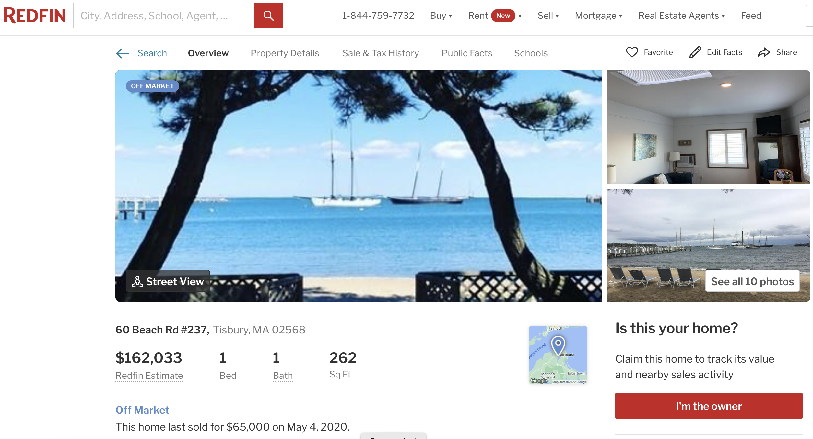


https://www.redfin.com/MA/Vineyard-Haven/60-Beach-Rd-02568/unit-237/home/135196757

